Slide 1
Analytics FOR BUSINESS Intelligence
Fall 2021
Nuria Diaz-Tena
Notes:
Attendance and Seating

Slide 2
Course Planning
# | Date | Topic | Assignments | Wg
1 | 9/01/21 | Introduction, Visualizations & Exploratory Data Analysis - Chapter 1
2 | 9/15/21 | Introduction to R
3 | 9/22/21 | Statistical Experiments | Homework #1 - EDA | 5%
4 | 9/29/21 | Regression – Chapter 2 and 3 | Homework #2 -Testing | 5%
5 | 10/06/21 | Inference
6 | 10/13/21 | Models Review
 | 10/20/21 | Midterm Exam | Midterm | 20%
7 | 10/27/21 | Review Midterm and R coding | Project #1 - Regression | 15%
8 | 11/03/21 | Tableau-1 & Classification Models – Chapter 4
9 | 11/10/21 | Tableau-2 & Bayesian Models | Homework #3 Classification Models | 5%
10 | 11/17/21 | Tableau -3 , Resampling - Chapter 5 & Machine Learning Models | Homework #4 - Bayesian Models | 5%
 |  | Thanksgiving Recess
11 | 11/29/21 | Advance Classification Models – Chapter6 to 9 els | Homework #5 ML | 3%
12 | 12/01/21 | Clustering - Chapter 10
13 | 12/06/21 | Project Discussion and Machine Learning Models Lab
14 | 12/08/21 | Final Exam Preparation | Project #2-Tableau, Data manipulation, visualizations, comparisons and modeling | 15%
 | 12/15/21 | Final Exam | Final | 20%
 |  |  | Collaboration & attendance | 7%

Slide 3
Agenda:
Review Tableau # 1
Review Project # 1
Assign Tableau # 2
Categorical Models
Assign Homework # 3 – Categorical Models in groups

Slide 4
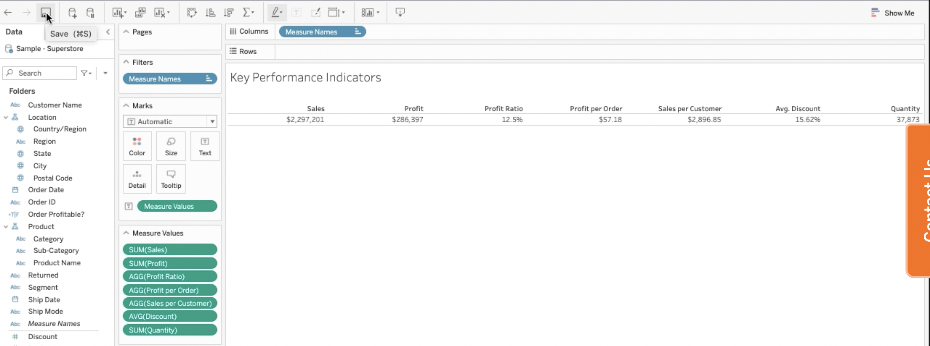
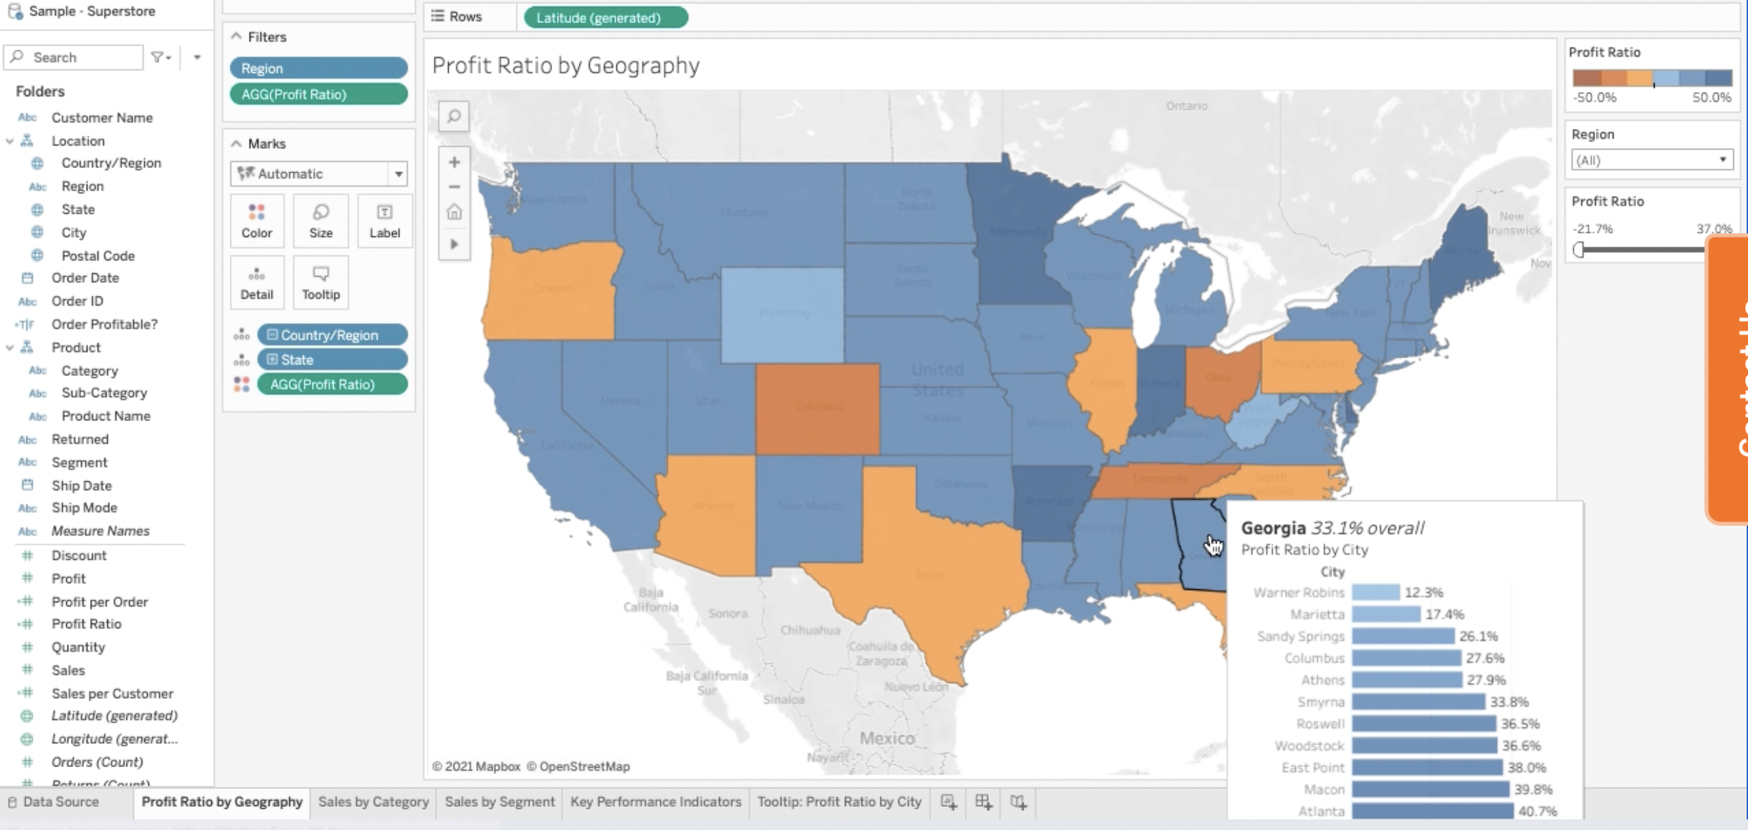
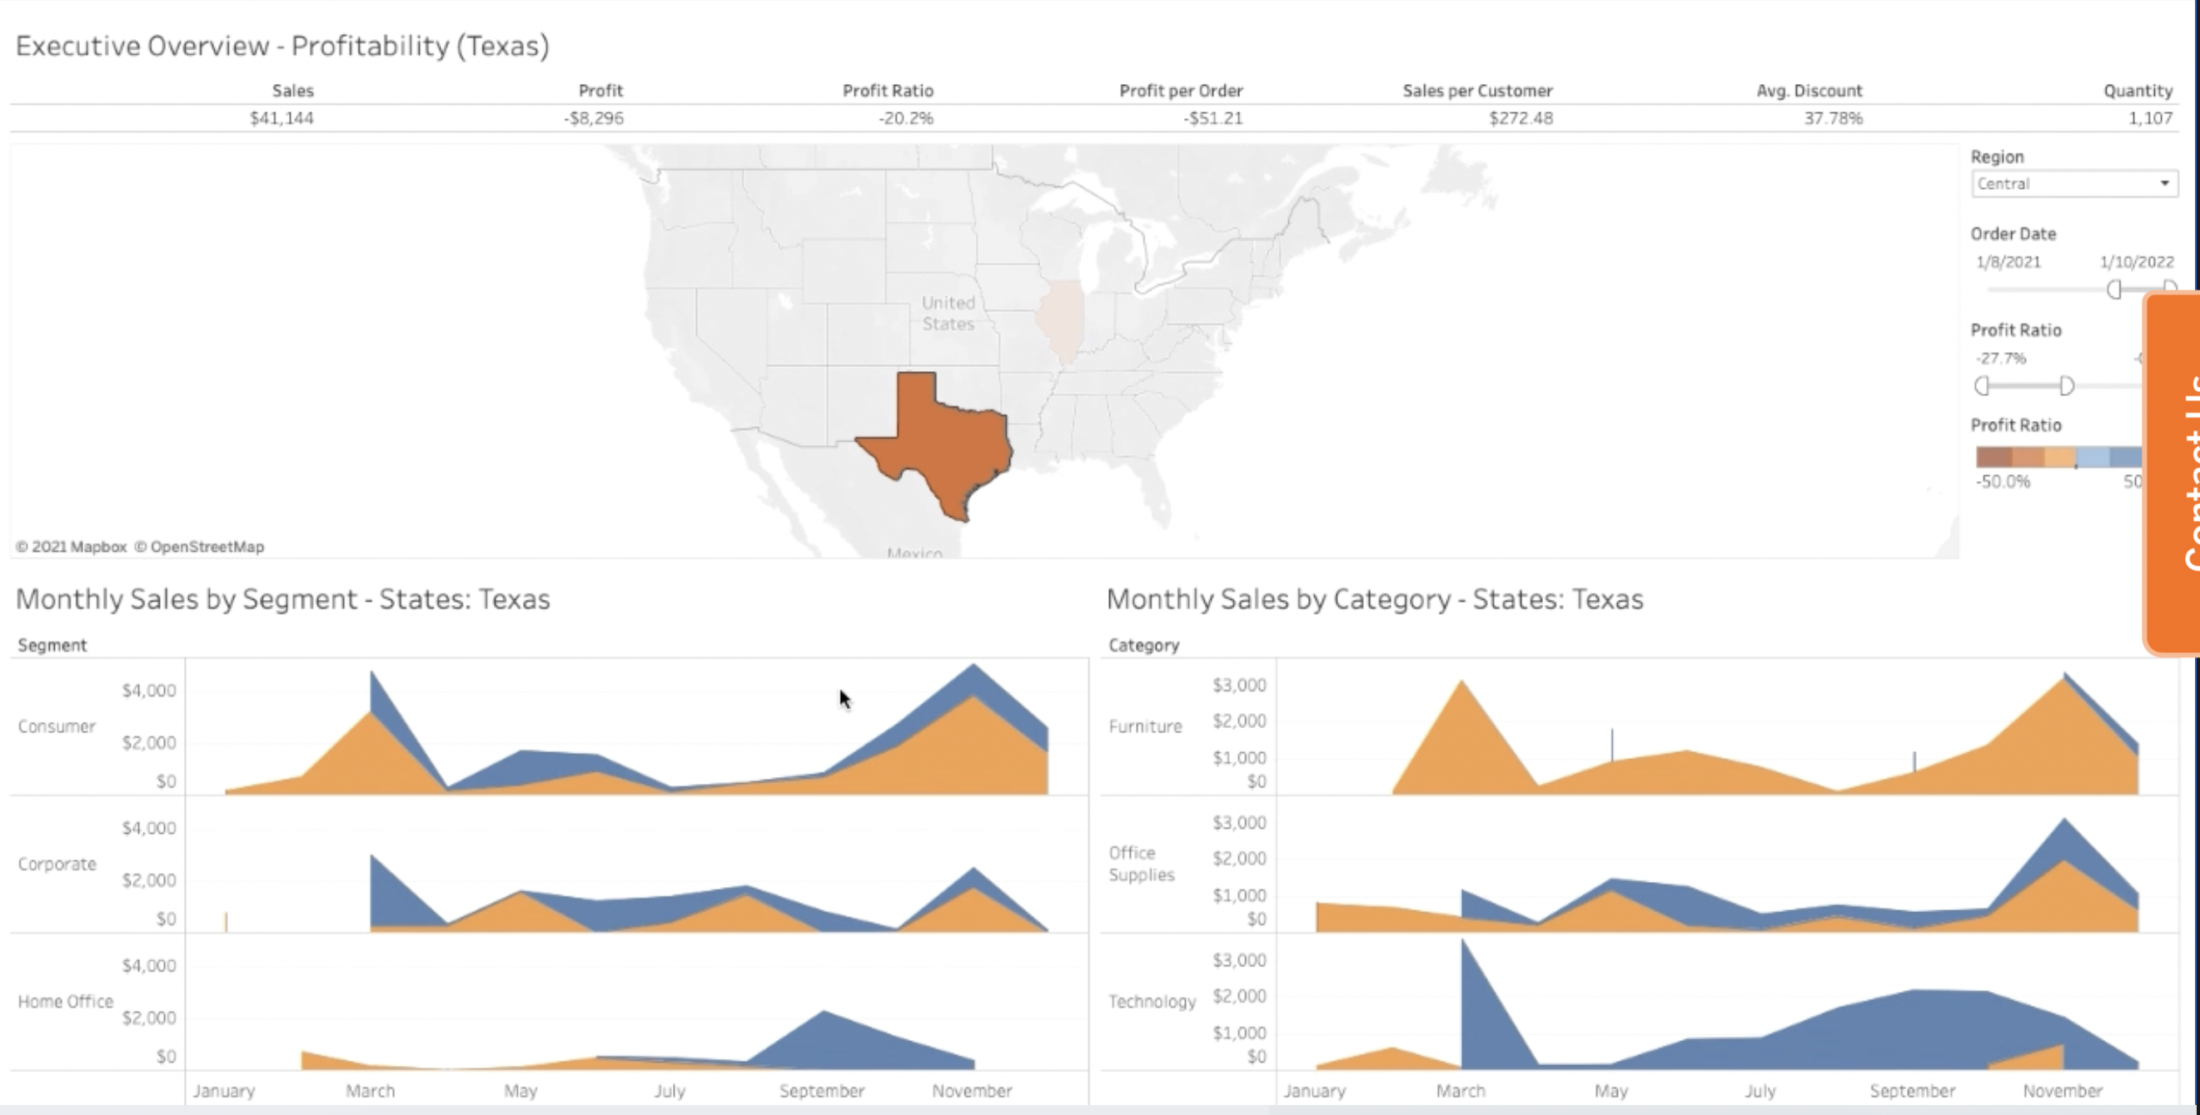
Tableau Practice:
BORAH, SAKSHI- Connecting the Data
Start by exploring “Orders sheet”
Add “Returns”
Save as [executive Overview]
GOPAL, GISHA– The workshop Area
Create Location and Product Category Hierarchy
LIU, CHI-KUEI– Map Profit Ratio by Geography
Rename the sheet as Profit Ratio by Geography
Compute Profit Ratio
Visualize Profit ratio by state
Format Colors
Filter by Region
TRIVEDI, BHAVYA AJAY– Sales by category, Sales by Segment
Plot Sales by Month-Year with an Area Plot
Show Profitable and unprofitable orders by color
Partition by categories
Filter by date
Copy your work and switch categories by segments
RAMIREZ, JERWIN– Text Tables - Key Performance Indicators
Compute Profit per order and Sales per costumer
Build the table on the right
SHAN, XINRUI – Bar Chart: Profit Ratio by city
Build a bar chart of Profit by city, sort it and add labels
Change the tooltip of Profit Ratio by Geography to show cities
SINGH, ROHIT – Building a Dashboard
Get all sheets on a dashboard
ADDARWAL, GHANISHT
SAVARAM, ANUSHA

Slide 5
Advertisement data – JOY, RIYA
Advertisement data on week 7 Description
Monthly Spend on TV, Radio and Newspaper advertisement and product Sales.
200 months with 4 variables
Use Tableau to:
Plot time trends
Summarize spends by year
Date | TV | radio | newspaper | sales
Jan-00 | 230.1 | 37.8 | 69.2 | 22.1

Slide 6
Review Project 1
Li Zhe
She Miao
Pravin Mahajan Pratik
Ye Peixin
Grading
Life expectancy 10pts
Best model including Female or Male Life Expectancy (-1)
Few models or not trying logs or poly (-0.5)
Using stepwise (+0.5)
Not providing model diagnosis (-1)
Not providing suggestions how to improve the model (-1)
Silly statements (-0.5)
Nice presentation (+0.5)
Boston Medv prediction 5 points

Slide 7
What is the main message of your results?
Make sure the questions are answered clearly
Can you tell me a story to understand and remember your conclusions?
Place all your work supporting your conclusions in the appendix

Slide 8
Brainstorm what the tell the client about predicting the Life Expectancy
Work on groups to figure out how to tell the story

Slide 9
Brainstorm what the tell the client about predicting the Life Expectancy
Overview of Life Expectancy with Map or Bar graph with remarks
Explanation of the variables provided and comments about them
Percent of variation explained by the estimated model (R-square). Challenges of the model and where to find all your supporting materials
Model could be improved by using the following information

Slide 10
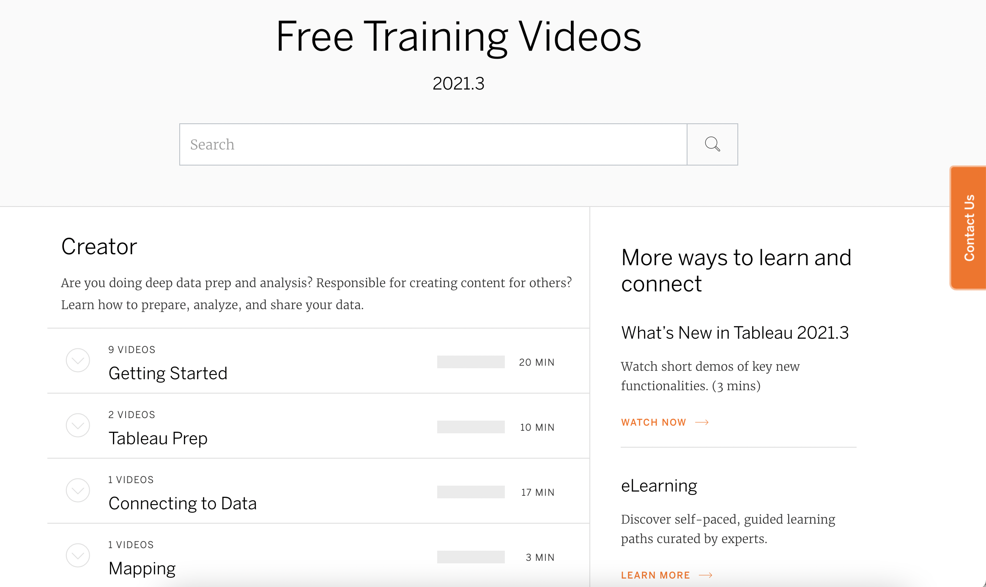
To Review:
Assign Tableau 2
Homework # 2 Review
Gauravkumar Vishwakarma
Niyati Aggarwal
Zida Wang
Linear Regression Summary
Haoyu Wang

Slide 11
Tableau Practice # 2
Helper 1 – Getting Started with Tableau Prep builder
Upload 2/28th file
Choose Mass Market Tab
Clean data by
Split Info
Split Last Week
Upload 2/21st
Clean
Output Union
Data Relationships
Helper 2 - What are the best and worst selling products?
Helper 3 -What was the contribution Margin by product?
Helper 4 - What were the sales revenue, profit and profit margin per category and product?
Helper 5 - Who are our most frequent customers?
Helper 6 - Who were our most profitable customers?
Helper 7 - For which categories did each customer purchase? And in what quantity?

Slide 12
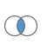
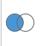

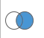
Merging data sets is a great source of LOST/MISSING data
HCP with sales & emails
Count 5,000
Sum emails 500,000
Sum of sales $40,000
HCP with emails
Count 10,000
Sum emails 1,000,000
HCP with sales
Count 6,000
Sales $50,000
Keep all HCPs in email data set
Count 10,000
Sum emails 1,000,000
Sum of sales $40,000
Missing sales
Keep all HCPs in both data sets
Count 11,000
Sum emails 1,000,000
Sum of sales $50,000
Missing sales and emails
Keep all HCP in sales data sets
Count 6,000
Sum of emails 500,000
Sales $50,000
Missing emails

Slide 13
1. Use GLM, LDA, QLD and K-NN to find the best model to predict “type” 2. Check how the models are performing on the testing data set
Homework # 3 Classification Models in Groups
library(MASS)
?Pima.te
In Power Point
Story Easy to Understand
State the Problem “Find the best predictions for diabetes on the Pima.te data set”
Describe how you are going to get the best prediction
Brief summary of the data
Compare the Accuracy of your best 6 models
Codes and calculations in Appendix

Slide 14
BAYESIAN Models

Slide 15
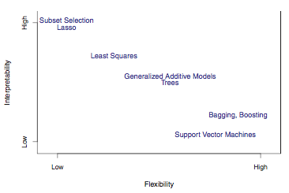
Types of Models
Model Form
Response Type
Parametric Model
f(X) = β0 +β1X1 +β2X2 +...+βpXp linear model
Regression Model
Numerical Response
Linear Regression
K-Nearest Neighbor
Boosting
Classification Model
Categorical Response
Logistic Regression
K-Nearest Neighbor
Boosting
Non-Parametric Model
f(X) = any model form of x flexible model
When should Lasso be used?
Less Flexible
More Interpretable
Sometimes you need specific variables in a model and those variables should have meaningful coefficients

Slide 16
Return of Investment Analysis (ROI)
What was the return of the investment in a particular advertisement channel?
How can my advertisement be improved/optimized?
I am provided the spend on:
TV
Radio
Newspaper
OOH
Banners
Mail, Email, Facebook, YouTube, etc…
I need a model with positive or insignificant coefficients on the above channels

Slide 17
BAYESIAN Models
Using Advertisement Data

Slide 18
Advertisement data
Advertisement data Description
Monthly Spend on TV, Radio and Newspaper advertisement and product Sales/50 in thousands.
200 months with 4 variables
Use Tableau to:
Plot time trends
Summarize spends by year
Date | TV | radio | newspaper | sales
Jan-00 | 230.1 | 37.8 | 69.2 | 22.1

Slide 19
Model Accuracy on Testing Set or Hold-out period
In time series data, the model is estimated approximately using 80% of the initial dates and it is forecasted to the last dates to check how the forecast is performing.
Advertising Data
Training Set: 2000 to 2013
Hold Out Period: 2014 to 2016

Slide 20
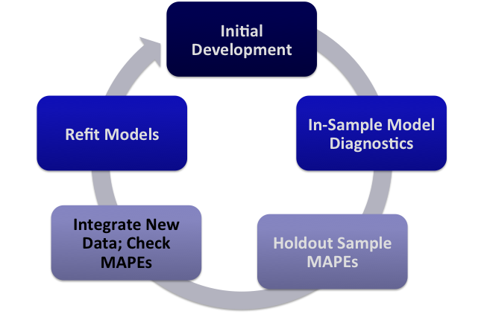
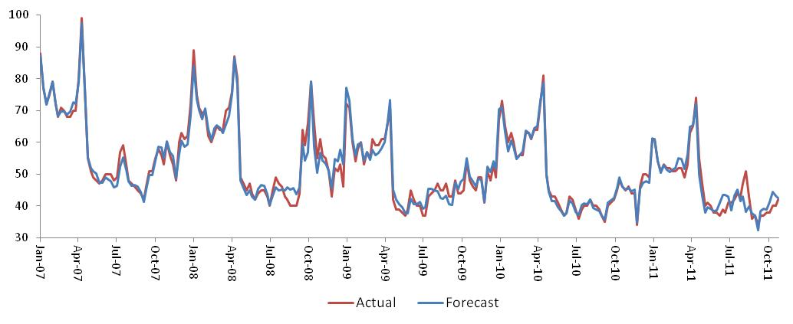
Internal model validation occurs at every step of the process using the most robust statistical tests
Holdout sample
Development MAPE | Holdout MAPE
5% | 7%
MAPE (Mean Absolute Percentage Error) is a measurement of model accuracy. In general, <5% is an excellent fit; 5% to 10 is a strong fit; 10 to 15% is a moderate fit.
MAPE = Mean (absolute value (Predicted – Actual)/Actual)

Slide 21
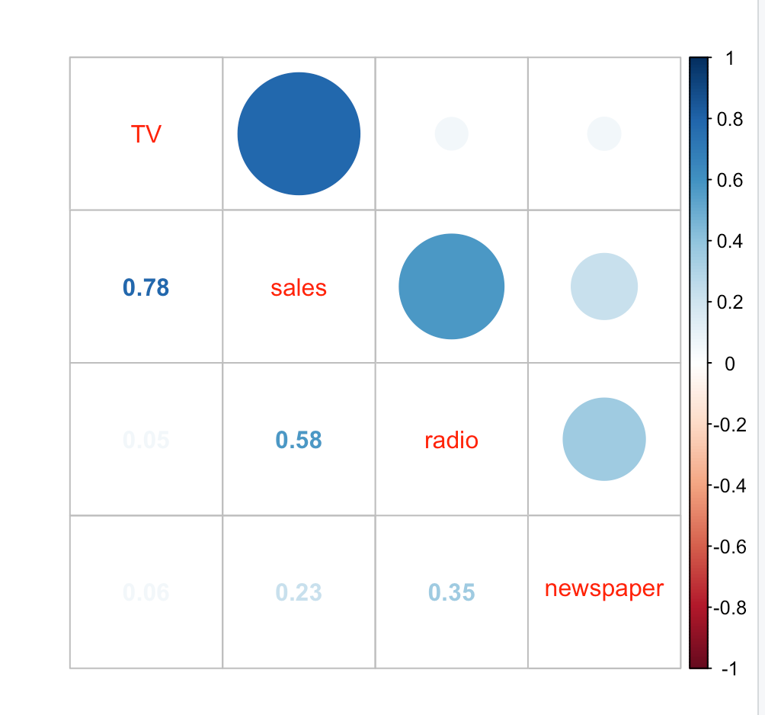
Are Sales associated with advertising?
data <- Advertising
data_num <- data[,2:5]
library(corrplot)
corrplot.mixed(cor(data_num), order = 'AOE’)
Sales is highly correlated the TV (correlation 78%), follow by radio (58%) and newspaper (23%)

Slide 22
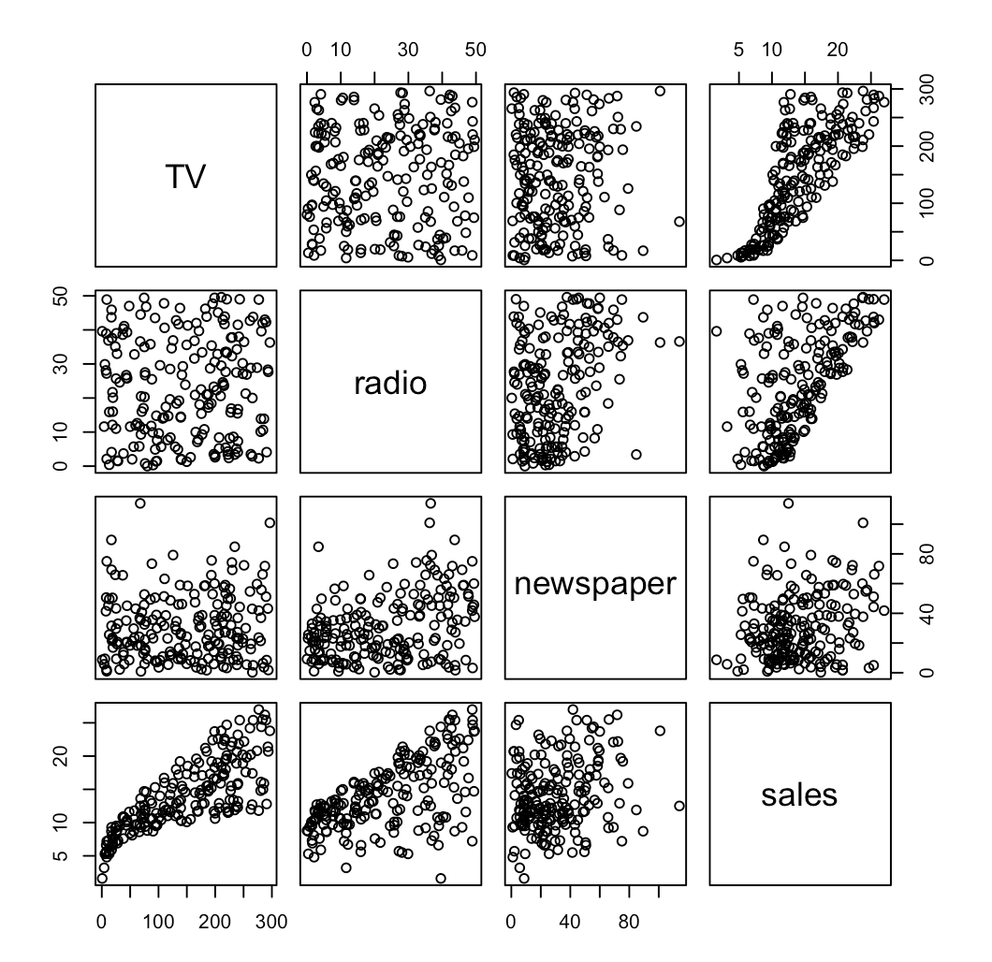
Is the relationship linear?
pairs(data_num)
The relationship is not linear.

Slide 23
Create a training set and a hold out period
data.df <- data.frame(data)
data.df.train <- subset(data.df,year<2014)
head(data.df.train)
dim(data.df.train)
data.df.test <- subset(data.df,year>2013)
head(data.df.test)
dim(data.df.test)
Training Set: 2000 to 2013
Hold Out Period: 2014 to 2016
We want to know the impact and ROI of TV, Radio and Newspaper Ads during the last year of data
What are the recommendations for 2017?
ROI_TV = Sales driven by TV advertisement / Spend on TV
Total ROI = Sales driven by advertisement/ Total advertisement spend
Net ROI = ROI * Gross Profit Margin

Slide 24
Which Model Form should be used?
Log-Log
Problems at ZERO SPEND
Log-hybrid
How do you pick K?
Linear
Sales = Base Demand * TV Investment ^{TV Lift Factor} * Radio Investment ^{Radio Lift Factor} * X_{i} ^{βi}* * error
Log(Sales ) = a + ßTV log(X_{TV}) + ßRadio log(X_{Radio}) +…+ error
Sales = β₀ * (X_{TV}/K_{TV}+1) ^{βTV} * (X_{Radio}/K_{Radio}+1)^{βRadio} * πX_{i} ^{βi} * error
Log(Sales ) = b + ß*TV log(X_{TV} /K_{TV}+1) + ßRadio log(X_{radio}/K_{radio}+1) +.+ error
Add a “saturation constant” K to flatten curve and model more realistic spend at the lower end of the curve
“Lift Factor” = 0.03
“Lift Factor“= 0.01
Most of our data exhibit diminishing returns (less incremental “bang for the buck” as you do more and more of a particular activity).
Background variables often make sense in percentage form (increase something by X% and you get Y% more sales)
NOTE: We use a panel time series regression model structure, adapted with hierarchical Bayesian priors
Notes:
Explain how a the log linear function turns into a multiplicative function.

Slide 25
Hybrid linear/log curves yield more realistic models
3
Linear Model
Revenue
Hybrid functions yield realistic ROIs across a wider range of values and retain the property of diminishing returns
Actual Spend
All forms have similar value near the actual spend
Log functions do not follow a realistic behavior near 0
Touchpoints
25

Slide 26
The models estimate the relationships between variables and their impact on one another by mapping synergy curves
Models estimate response curves for each variable subject to the presence or absence of other variables
Synergy curves reflect marginal returns – i.e., the next dollar spent may return more or less than the previous dollar
These curves are estimated for every possible combination of variables
Radio curves for different levels of TV
TV curves for different levels of radio
Observations
Paid Search Spend
Sales
TV Spend

Slide 27
Example using Hybrid Model Form
Medium TV (more “elastic”)
Sales
1.25x increase in revenue from a $1x increase in TV
End Benefits
Identify the saturation points for each marketing/media touchpoint
Determine which marketing vehicles to spend more/less
Based on where you are on the response curves, taking into consideration any constraints on where/how funds can realistically be spent
Medium Radio (less “elastic”)
0.25x decrease in revenue from a $1x decrease in Radio
Incremental Revenue of Radio
Current spend
Incremental Revenue of TV
Optimal spend
Marketing Spend

Slide 28
Bayesian methods -- Traditional regression does not allow us to incorporate outside information into the models
Classical regression models treat parameters (coefficients) as fixed but unknown. All the information needed to develop equations is assumed to be contained in the historical data used for modeling
Bayesian regression treats parameters as random variables that have normal distributions. The distributions of the parameters depend on the historical dataset used for modeling, and “outside information”
It is an ideal technique for getting robust granularity and incorporating results from historical data
Also useful to break colinearity, including desired variables in the model with proper signs and coefficients

Slide 29
Visualizing Bayesian methods
Mean of posterior distribution is between that of the Prior and the data distribution
Standard deviation of posterior distribution is smaller than that of the prior and the classical regression
The standard deviation of the prior determines how much the classical estimate is shrunk towards to the prior
Posterior Distribution
“Data” Distribution
Prior Distribution

Slide 30
Statistical tests are balanced against marketing sensibility, and where necessary against client needs
Marketing Sensibility
Check for acceptable measures 1) Marketing contribution, 2) Source of volume change, and 3) touch point relative effectiveness (coefficient)
Check for multicollinearity to avoid bias
Conduct sanity check against known business truths and client existing knowledge
Reconciliation vs. other research
Statistical Fit
Average weekly error, t-Statistic, MAPE
Actual vs. predicted volume, trend matching
Holdout on new time periods and ability to develop accurate forecasts
Evaluate times series structure of the error, confirming independent and identically distributed
t-Stat
MAPE
Prior Knowledge
Coefficient Sign
Stats
Sensibility
❑
❑

Slide 31
Identify and collect data from sources to inform defined questions
Our analytical approach enables you to account for a more comprehensive set of business drivers
PR
Product
Earned
Organic Search
Quality
Controllable
WOM
Google
Bing
Innovation
Brand
Conferences
Events
Social Media
Twitter
Blogs
Trade Shows
Sales
Facebook
Awareness
Training
Details
Website
Commerce
Formulary
Owned
Content
Consideration
Displays
Distribution
Google
Purchase
Pharmacy Initiatives
Paid Search
Bing
Vouchers
Banner Ads
Samples
Promotions
Display
Coupons
Video Ads
Magazine
Competition
Print
Offering
Newspaper
Pricing
Journals
TV
Regulatory Environment
Broadcast
Stock Market
Radio
Signs
Interest Rates
Non-controllable
Paid
Outdoor
Direct Mail
Mobile
Employment
rates
Economy
Digital Signage
email

Slide 32
Visualizations and Tables
TV spend and sales Trend
Radio spend and sales Trend
Newspaper spend and sales trend
Table and plot of advertisement spend and sales by year.
Table of advertisement s[end and sales last year

Slide 33
Models to start with
Base model: Step regression to select seasonality and trend
Base model for log(sales): Step regression to select seasonality and trend
Call:
lm(formula = sales ~ dum_hig, data = data)
Residuals:
Min 1Q Median 3Q Max
-594.31 -189.31 -45.67 183.19 675.69
Coefficients:
Estimate Std. Error t value Pr(>|t|)
(Intercept) 674.31 22.62 29.812 <2e-16 ***
dum_hig 77.72 38.51 2.018 0.0449 *
---
Signif. codes: 0 ‘***’ 0.001 ‘**’ 0.01 ‘*’ 0.05 ‘.’ 0.1 ‘ ’ 1
Residual standard error: 258.9 on 198 degrees of freedom
Multiple R-squared: 0.02016, Adjusted R-squared: 0.01521
F-statistic: 4.073 on 1 and 198 DF, p-value: 0.04492
Call:
lm(formula = log(sales) ~ dum_low, data = data.df.train)
Residuals:
Min 1Q Median 3Q Max
-1.95512 -0.24182 0.01286 0.31732 0.80962
Coefficients:
Estimate Std. Error t value Pr(>|t|)
(Intercept) 6.52174 0.03672 177.607 <2e-16 ***
dum_low -0.18459 0.07344 -2.514 0.0129 *
---
Signif. codes: 0 ‘***’ 0.001 ‘**’ 0.01 ‘*’ 0.05 ‘.’ 0.1 ‘ ’ 1
Residual standard error: 0.4122 on 166 degrees of freedom
Multiple R-squared: 0.03666, Adjusted R-squared: 0.03086
F-statistic: 6.318 on 1 and 166 DF, p-value: 0.01291
>

Slide 34
Adstocks – Build and Decay
Advertising adstock or advertising carry-over is the prolonged or lagged effect of advertising on consumer purchase behavior. Adstock is an important component of marketing-mix models. The term "adstock" was coined by Simon Broadbent.[1] Adstock is a model of how response to advertising builds and decays in consumer markets. Advertising tries to expand consumption in two ways; it both reminds and teaches. It reminds in-the-market consumers in order to influence their immediate brand choice and teaches to increase brand awareness and salience, which makes it easier for future advertising to influence brand choice. Adstock is the mathematical manifestation of this behavioral process.

Slide 35
Code Adstocks
Suppose that the advertisement this month is still remembers at 50% the following month
Advertisement_add (t) = (advertisement(t) + 0.5*
advertisement(t-1))/1.5

Slide 36
Add advertisement - linear
Call:
glm(formula = sales ~ dum_hig + TV_add + radio_add + news_add,
family = gaussian, data = data.df.train)
Deviance Residuals:
Min 1Q Median 3Q Max
-334.65 -81.56 4.06 100.45 315.95
Coefficients:
Estimate Std. Error t value Pr(>|t|)
(Intercept) 35.7625 36.1669 0.989 0.324
dum_hig -15.5210 23.1448 -0.671 0.503
TV_add 3.0242 0.1675 18.052 <2e-16 ***
radio_add 11.1344 1.0790 10.319 <2e-16 ***
news_add -1.0457 0.6623 -1.579 0.116
---
Signif. codes: 0 ‘***’ 0.001 ‘**’ 0.01 ‘*’ 0.05 ‘.’ 0.1 ‘ ’ 1
(Dispersion parameter for gaussian family taken to be 17809.07)
Null deviance: 11034300 on 167 degrees of freedom
Residual deviance: 2902878 on 163 degrees of freedom
AIC: 2128
Number of Fisher Scoring iterations: 2
Did you estimate a model with positive coefficients using all three advertisement channels?
The model estimate positive impacts for TV and radio and negative (non-significant ) impact for newspaper
Residual patterns

Slide 37
Add advertisement – log-hybrid
Use a k = 26 for TV,
k= 4 for radio
k= 3 for Newspaper
(approx. 20% of average
Call:
glm(formula = log(sales) ~ dum_low + log(TV_add + 26) + log(radio_add +
4) + log(news_add + 3), data = data.df.train)
Deviance Residuals:
Min 1Q Median 3Q Max
-1.23736 -0.13283 0.01664 0.15748 0.51958
Coefficients:
Estimate Std. Error t value Pr(>|t|)
(Intercept) 1.80852 0.26179 6.908 1.05e-10 ***
dum_low -0.07888 0.04201 -1.878 0.0622 .
log(TV_add + 26) 0.73267 0.04333 16.911 < 2e-16 ***
log(radio_add + 4) 0.31775 0.04106 7.738 9.98e-13 ***
log(news_add + 3) -0.01428 0.03436 -0.416 0.6782
---
Signif. codes: 0 ‘***’ 0.001 ‘**’ 0.01 ‘*’ 0.05 ‘.’ 0.1 ‘ ’ 1
(Dispersion parameter for gaussian family taken to be 0.0540831)
Null deviance: 29.2757 on 167 degrees of freedom
Residual deviance: 8.8155 on 163 degrees of freedom
AIC: -6.4078
Number of Fisher Scoring iterations: 2
Did you estimate a model with positive coefficients using all three advertisement channels?
The model estimate positive impacts for TV and radio and negative (non-significant ) impact for newspaper
Obs 131 (Nov 2010) should be explored. Nov 2012 has very low sales. Suggestion – Include a Nov-10 dummy to reduce outliers and check if the rest of the coefficients change

Slide 38
Add advertisement to log-log
Call:
glm(formula = log(sales) ~ dum_low + log(TV_add) + log(radio_add) +
log(news_add), data = data.df.train)
Deviance Residuals:
Min 1Q Median 3Q Max
-1.07543 -0.15559 -0.00033 0.15445 0.65568
Coefficients:
Estimate Std. Error t value Pr(>|t|)
(Intercept) 3.152552 0.199531 15.800 < 2e-16 ***
dum_low -0.082358 0.043337 -1.900 0.0591 .
log(TV_add) 0.563612 0.034777 16.206 < 2e-16 ***
log(radio_add) 0.203323 0.029601 6.869 1.3e-10 ***
log(news_add) -0.001571 0.029598 -0.053 0.9577
---
Signif. codes: 0 ‘***’ 0.001 ‘**’ 0.01 ‘*’ 0.05 ‘.’ 0.1 ‘ ’ 1
(Dispersion parameter for gaussian family taken to be 0.05739741)
Null deviance: 29.2757 on 167 degrees of freedom
Residual deviance: 9.3558 on 163 degrees of freedom
AIC: 3.5844
Number of Fisher Scoring iterations: 2
F-statistic: 86.76 on 4 and 163 DF, p-value: < 2.2e-16
Did you estimate a model with positive coefficients using all three advertisement channels?
The model estimate positive impacts for TV and radio and negative (non-significant ) impact for newspaper
Obs 109 and 131 are problematic

Slide 39
Sheapley Values – help on breaking collinearity between Newspaper and radio
Example
Model 1 - Sales = Intercept1 + coeff1-Radio* Radio + coef11* dum + coeff12* TV
Model 2 - Sales = Intercept2 + coeff2-Newspaper* Newspaper + coef21* dum + coeff22* TV
Model 3 - Sales = Intercept3 + coeff3-Radio*Radio + coeff3-Newspaper* Newspaper+ coef31* var 1 + coeff32* var 2
What can happened?
Radio and Newspaper are independent:
coeff1-Radio = coeff3-Radio
coeff2-Newspaper = coeff3-Newspaper
Use Model 3 with Radio and Newspaper
TV and Radio are extremely correlated
coeff1-Radio < coeff3-Radio
coeff2-Newspapaper > coeff3-Newspaper and coeff3-Newspaper is Negative
Let’s code a combination variable
RadioNewspaper = coeff1-Radio /(coeff1-Radio +coeff2-Newspaper) * Radio + coeff2-Newspaper /(coeff1-Radio +coeff2-Newspapaper) * Newspaper
Use the combination variable instead of the two separate variables
Model 4 - Sales=Intercept4+coeff4-RadioNewspaper*RadioNewspaper+coef31*var1+coeff32*var2
Compute priors for Bayesain model:
TV Prior = coeff4-TVRadio * coeff1-TV /(coeff1-TV +coeff2-Radio)
Radio Prior = coeff4-TVRadio * coeff2-Radio /(coeff1-TV +coeff2-Radio)

Slide 40
Sheapley Values
Call:
glm(formula = log(sales) ~ dum_low + log(TV_add + 26) + radnews, data = data.df.train)
Deviance Residuals:
Min 1Q Median 3Q Max
-1.20118 -0.14595 0.01449 0.16167 0.52209
Coefficients:
Estimate Std. Error t value Pr(>|t|)
(Intercept) 1.71652 0.26157 6.562 6.64e-10 ***
dum_low -0.08306 0.04247 -1.956 0.0522 .
log(TV_add + 26) 0.73130 0.04384 16.682 < 2e-16 ***
radnews 0.33022 0.04333 7.621 1.91e-12 ***
---
Signif. codes: 0 ‘***’ 0.001 ‘**’ 0.01 ‘*’ 0.05 ‘.’ 0.1 ‘ ’ 1
(Dispersion parameter for gaussian family taken to be 0.05537971)
Null deviance: 29.2757 on 167 degrees of freedom
Residual deviance: 9.0823 on 164 degrees of freedom
AIC: -3.4001
Number of Fisher Scoring iterations: 2
Example
Model 1 -Remove Newspaper to the model you had
COEFF_log(radio_add + 4) = 0.31238
Model 2 – Remove Radio to the model you had
COEFF log(news_add + 3) = 0.06939
What can happened?
TV and Radio are correlated
coeff1-Radio < coeff3-Radio
coeff2-Newspapaper > coeff3-Newspaper and coeff3-Newspaper is Negative
Let’s code a combination variable
Radio is 81.82% = 0.31238/(0.31238+0.06939)
Newspaper is 18.18% = 0.06939/(0.31238+0.06939)
RadioNewspaper = 81.82% * Radio + 18.18% * Newspaper
Use the combination variable instead of the two separate variables
Model 4 - log(Sales)=Intercept4+coeff4-RadioNewspaper*RadioNewspaper+coef31*var1+coeff32*var2

Slide 41
Create a training set and a hold out period
How is your model performing on the Training Set (2000 to 2013)? MAPE = 17%
How id your model performing on the Hold Out Period (2014 to 2016)? MAPE = 15%
We want to know the impact and ROI of TV, Radio and Newspaper Ads during the last year of data
What are the recommendations for 2017?
Reduce TV spend
Increase Radio spend
Increase Newspaper spend
METRIC | TV | RADIO | NEWSPAPER
Spend | $1,579 | $228.1 | $183.3
Sales | $7,755 | $7,755 | $7,755
Impact | $4,332 | $5,781 | $6,125
ROI | 2.74 | 25.35 | 33.42

Slide 42
Tableau Practice # 3
Helper 1 – Getting Started with Tableau Prep builder
Upload 2/28th file
Choose Mass Market Tab
Clean data by
Split Info
Split Last Week
Upload 2/21st
Clean
Output Union
Data Relationships
Helper 2 - What are the best and worst selling products?
Helper 3 -What was the contribution Margin by product?
Helper 4 - What were the sales revenue, profit and profit margin per category and product?
Helper 5 - Who are our most frequent customers?
Helper 6 - Who were our most profitable customers?
Helper 7 - For which categories did each customer purchase? And in what quantity?
Helper 8 – Mapping.
Use the COVID data to plot the total number of COVID deaths by state till August 2021
Show the life expectancy by country
Helper 9 – Calculated Field
Calculate the weight gain by each female in the Anorexia data
Helper 10 – Tableau 2020.1 Visual Analytics. Getting started
Plot Sales over time
Scatterplot of Profit by shipping
Helper 11 – Tableau 2020.1 Sorting

Slide 43
Goal of Resampling
Resampling methods involve repeatedly drawing samples from a training set and refitting a model of interest on each sample in order to obtain additional information about the fitted model.
What is model assessment? The process of evaluating a model’s performance
What is model selection? The process of selecting the proper level of flexibility
cross-validation can be used to estimate the test error associated with a given statistical learning method in order to evaluate its performance, or to select the appropriate level of flexibility.
Bootstrap is used in several contexts, most commonly to provide a measure of accuracy of a parameter estimate or of a given statistical learning method

Slide 44
Project # 1. Life Expectancy – 10pts
Student | MaleFemale(-1) Poor (-0.5) Step(+0.25,0.5,0.75) | Model diagnostic(-0.5 or -1) No improvements (-1) | Boston Copied (2.5), Poor (3), As exam (4) | Story (+0.5)
3. ADDARWAL, GHANISHT | Same as 6
4. AGGARWAL, NIYATI | Simple one lnear (-1) | (+0.5)Nice overview R-Square not adjusted (-0.25) | Leverage (-0.25)
5. ASHOK, ASHOK KARTHIK | Only linear (-0.25) | Diagnostic com(-0.25) No improvements(-1) | 4
6. BORAH, SAKSHI | Onlly linear, VIF and conclusions inclorrect | 77% Step forward, backward and both | Patterns and outliers | Good suggestions
 | Not clear wining model
9. CHEN, RACHEL |  | 99% including LE_female and male | Boston only linear | No suggestions
8. CHOUHAN, GARIMA | Only linear (-0.25) | (+0.5)Nice overview Step forward, backward and both99% including LE_female and male (-1) | 71% Boston | OK suggestions
9. GOON, INDRAKSHEE GOON |  | Female and Male | 70% T-square Boston | No conclusions
10. GOPAL, GISHA |  | Amazing Table of models | No Patterns or others | No adding var
11. GOTHIVAREKAR, ANVAY PRAVIN | Only linear
12. GULATI, SIMRAN KAUR CHARANJIT S | (-0.25) only linear only 2 models (-1) | (-1) Male and Female) |  | Ok sugestions
HINDUJA, JAI | 1. no poly, added log | 68% | No | Good suggestions
 | 1. | 70%
14. HUNGUND, AJINKYA | Poor (-0.5 | Model diag (-0.25) No Imp(-1) | 3.5
JADHAV, ADITYA DILIP | Only linear Teerible coding | (-1 Male and Female) |  | No additional var (-1)

Slide 45
Project # 1. Life Expectancy – 10pts
Student | MaleFemale(-1) Poor (-0.5) Step(+0.25,0.5,0.75) | Model diagnostic(-0.5 or -1) No improvements (-1) | Boston Copied (2.5), Poor (3), As exam (4) | Story (+0.5)
KARKERA, RAKSHIT MANOHAR | Poor (-0.25) | No No comments no sug (-1.25) | Less than exam no comments
17. LI, ZHE | Only linear (-0.25) |  | Similar to exam
LIU, CHI-KUEI
JOY, RIYA | Poor model | Awesome suggestions | Poor and no commets
20. PRAVIN, MAHAJAN PRATIK | Poor (-0.5) | Mode (-0.5) No Im (-1) | 4
MODI, JANVI | Lots of models (+0.5 using step) | Diagnositc comments (-0.25) | Les than exam
PABARI, NISHIT PARESH | Male and Female (-1) | Diagnostic com(-0.25) no suggetins (-1) | Linear all and log(medv)
23. PAI, ADITYA GAJANAN | Male and Female (-1) | Diagnostic com(-0.25) | Less than exam 3
RAMIREZ, JERWIN | Male and Female (-1) | Diagnostic com(-0.25) | Poor 3
SAVARAM, ANUSHA | Good only linear (-0.25) | Diagnostic com(-0.25) | Seems copuied form amazon
26. SHAH, JASH PRASHANT | Male and Female (-1) |  | 2.5
27. SHAH, KARAN KETAN | Male and Female (-1) Only linear (-0.5) | Diagnostic com(-0.25) No improvements(-1) | 4
SHAH, MIHIR SANJAY | Male and Female (-1) Only linear (-0.5) | Diagnostic com(-0.25) No improvements(-1) | 2.5

Slide 46
Project # 1. Life Expectancy – 8pts
Student | MaleFemale(-1) Poor (-0.5) Step(+0.25,0.5,0.75) | Model diagnostic(-0.5 or -1) No improvements (-1) | Boston Copied (2.5), Poor (3), As exam (4) | Story (+0.5)
SHAH, RUSHABH NIPUL | Male and Female (-1) Only linear (-0.5) Stepwise(+0.5) | Diagnostic com(-0.25) No improvements(-1) | 2.5
SHAH, YASH PARAG | Male and Female (-1) Only linear (-0.5) | Diagnostic com(-0.25) No improvements(-1) | 2.5
SHAN, XINRUI | No regressions (-5) |  | Missing
SHARMA, PRERNA | Only linear (-0.5) | Diagnostic com(-0.25) No improvements(-1) | 5
SHE, MIAO | Very Good |  | 5
SINGH, ROHIT | Male and Female (-1) Only linear (-0.5) |  | 4
TALELE, ASHISH SANJAY | Only linear (-0.5) | Diagnostic com(-0.25) No improvements(-1) | 3.5
TRIVEDI, BHAVYA AJAY | Male and Female (-1) Only linear (-0.5) | Diagnostic com(-0.25) No improvements(-1) | 2.5
UBRIANI, ANUSHKA | Only linear (-0.5) | Diagnostic com(-0.25) No improvements(-1) | 4
VISHWAKARMA, GAURAVKUMAR | Log(a+B) (-0.25) | No improvements(-1) | 4
WANG, HAOYU |  | Diagnostic com(-0.25) No improvements(-1) | 4
WANG, ZIDA | Only linear (-0.5) | Diagnostic com(-0.25) No improvements(-1) | 3
YE, PEIXIN | Step (+0.5) | (-1) | 5 | +0.5

Slide 47
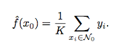
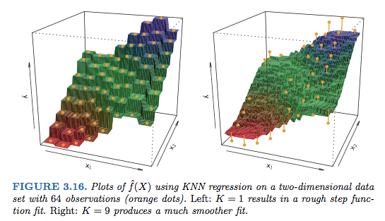
K-Nearest Neighbor
In what setting will a parametric approach such as least squares linear regression outperform a non-parametric approach such as KNN regression?
The answer is simple: the parametric approach will outperform the non- parametric approach if the parametric form that has been selected is close to the true form of f.
^{How can you know that?}
Try both methods and compare

